Slide 1
SuperMASSA training section
Marcelo Mollinari
mmollin@ncsu.edu
SCRI Workshop – January 13, 2021
This work is licensed under CC BY 4.0

Slide 2
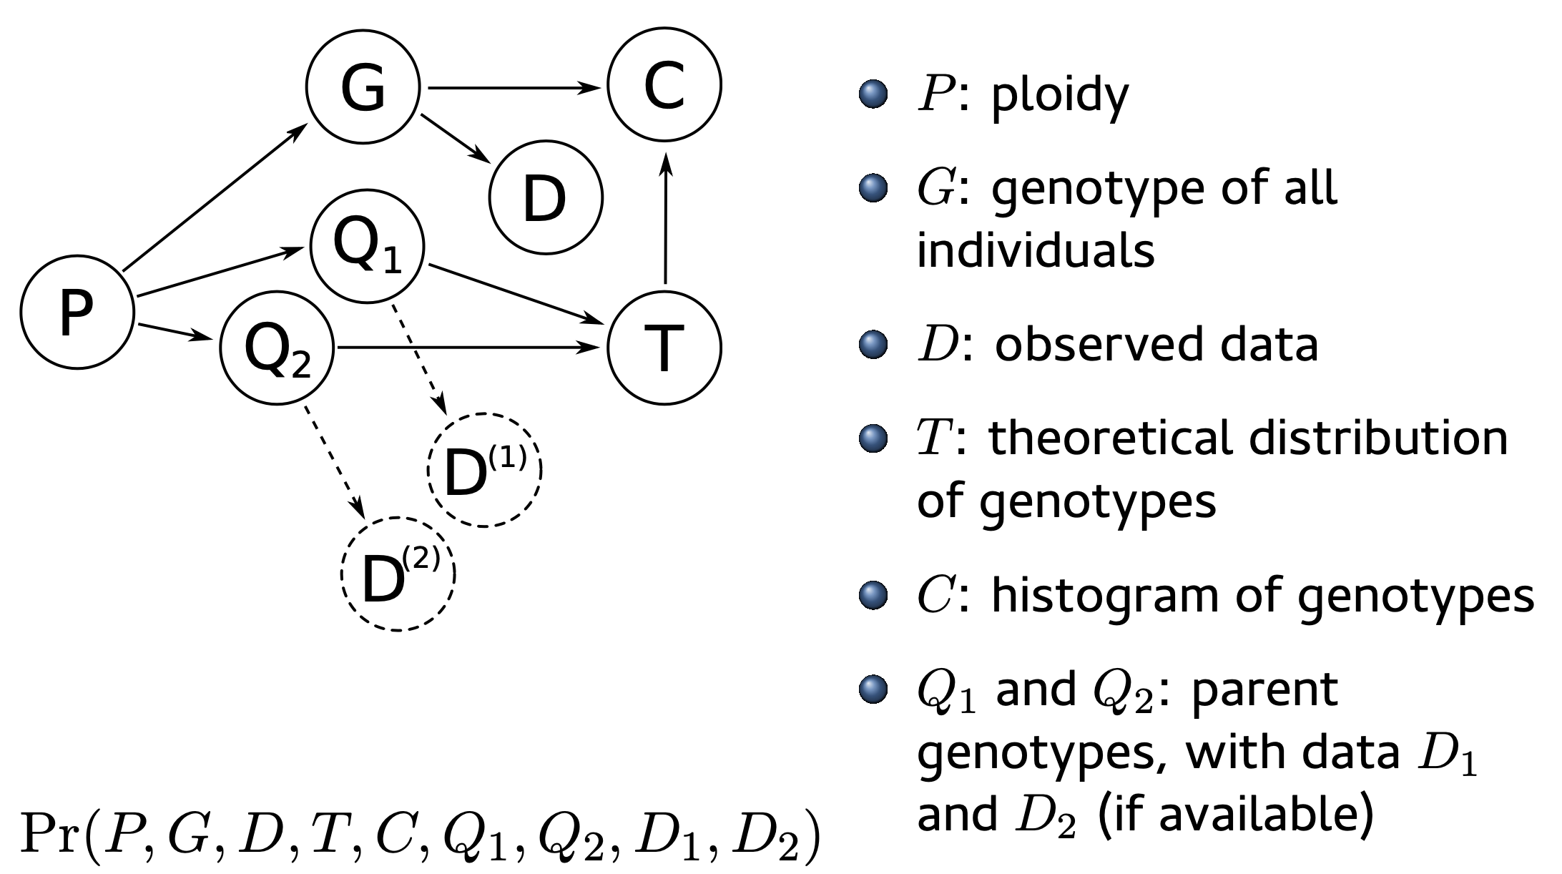
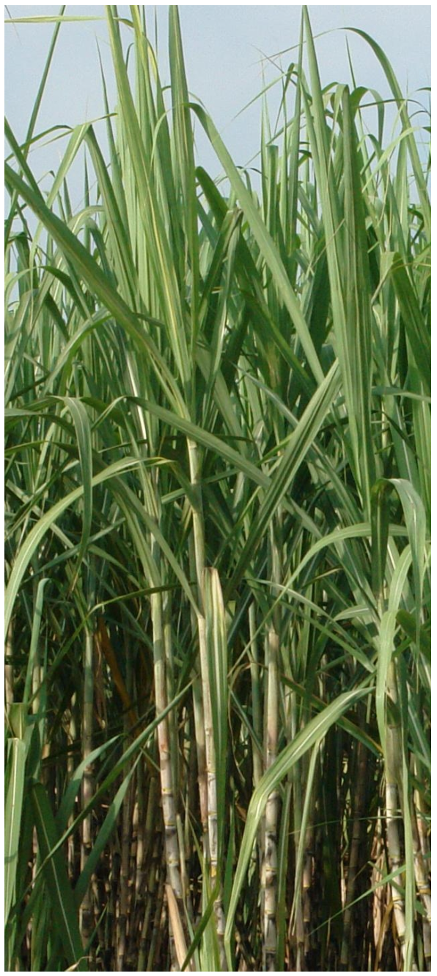
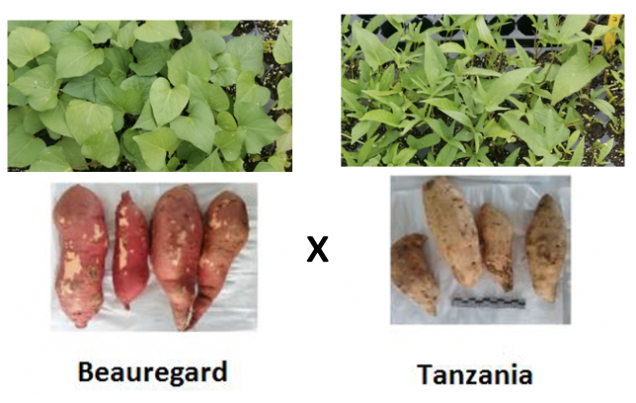
Outline
Introduction to the model (intuition)
Ploidy estimation in a sugarcane biparental population
Genotype calling in a sweetpotato biparental population using VCF2SM

Slide 3
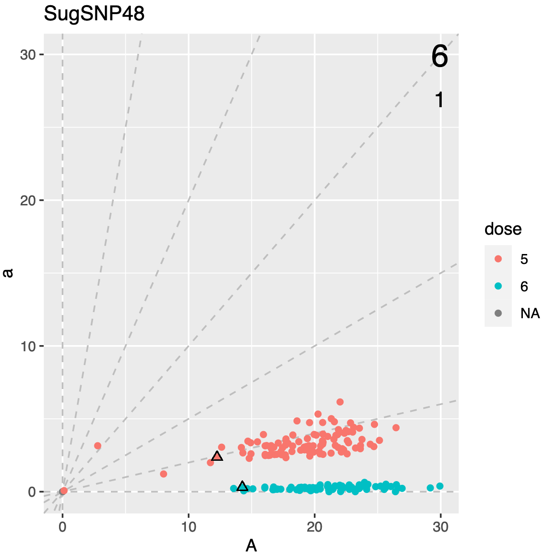
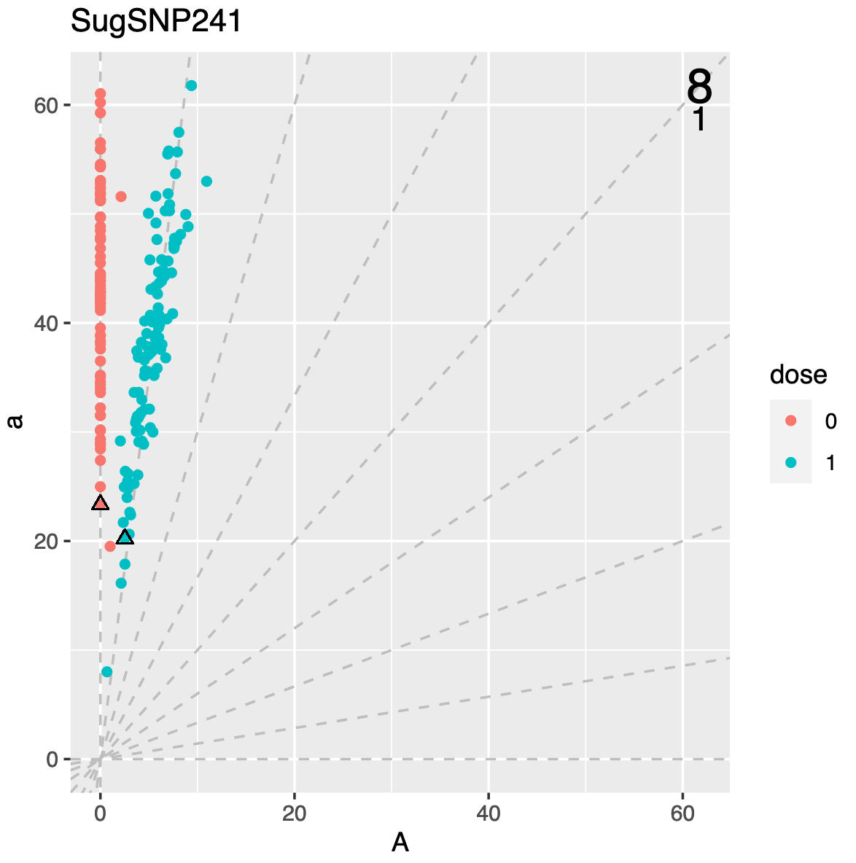
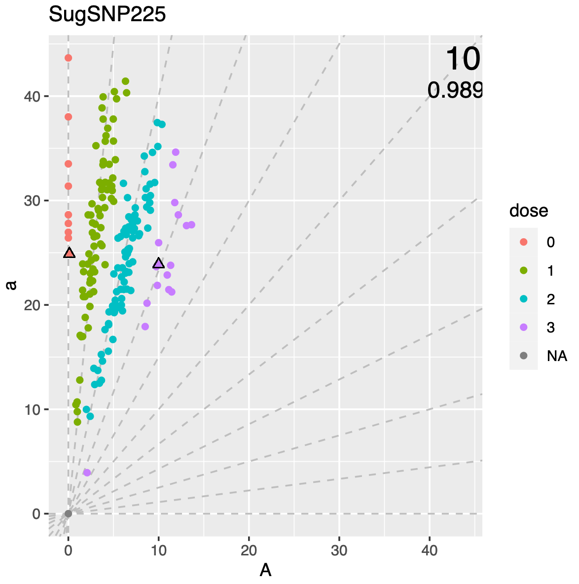
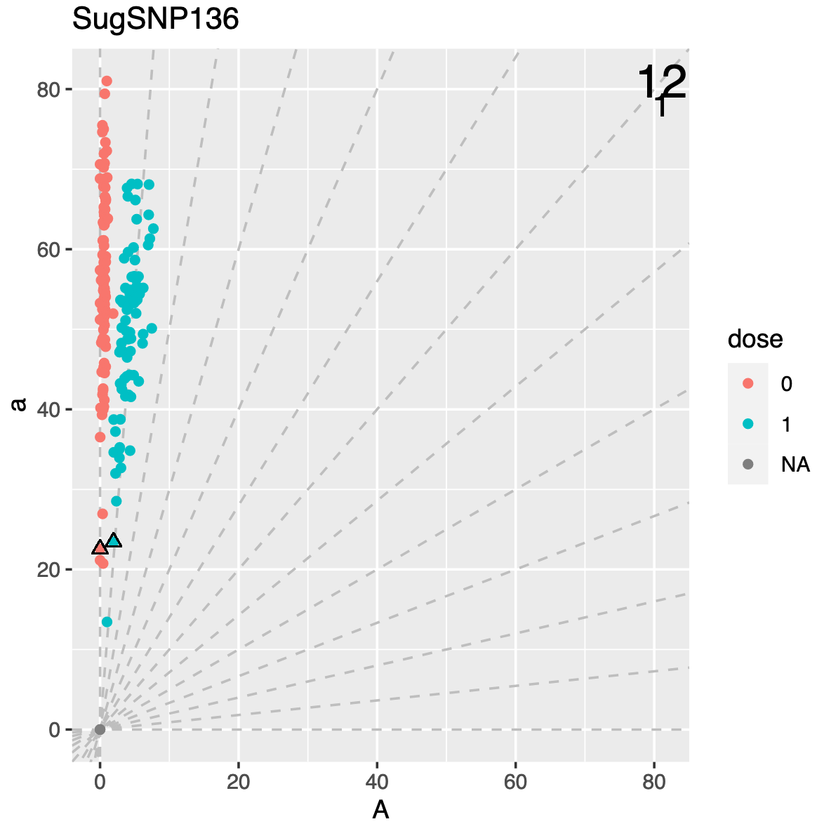
SuperMASSA’s probabilistic graphical model
SuperMASSA is a software developed to infer ploidy levels and perform genotype calling using dosage-based molecular markers
It uses the ratio between the abundance of two allelic variants in a probabilistic graphical model to compute the maximum a posteriori configuration of the network

Slide 4
Probabilistic graphical model – F1
https://doi.org/10.1371/journal.pone.0030906

Slide 5
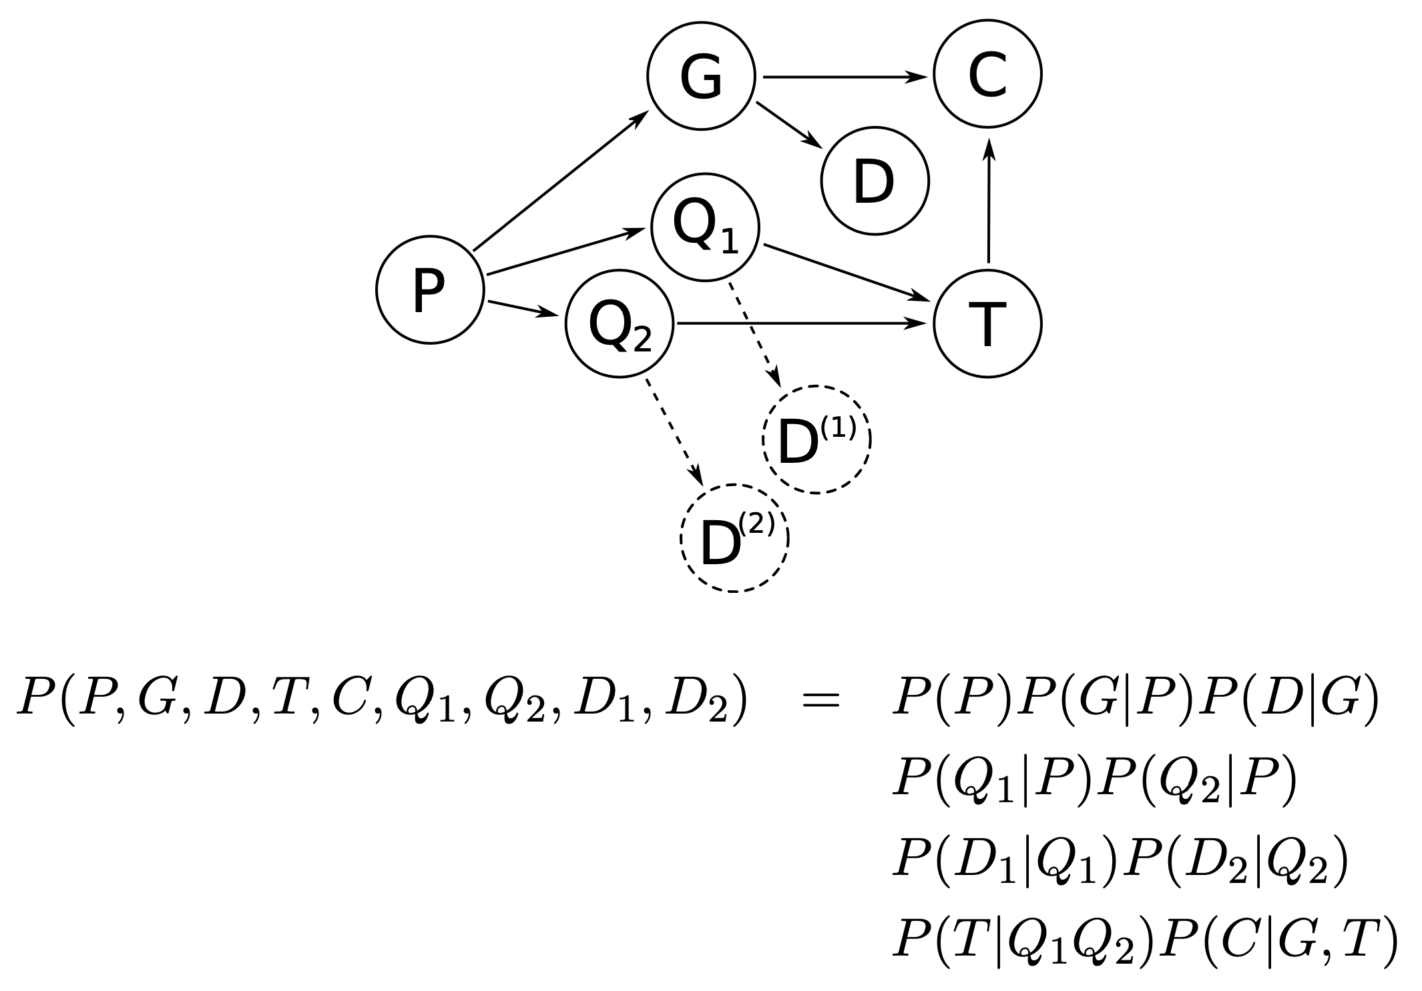
Probabilistic graphical model
Maximum a posteriori configuration: It is the configuration (set of assignments) that maximizes the joint probability of the network, given the evidences (observed data)

Slide 6
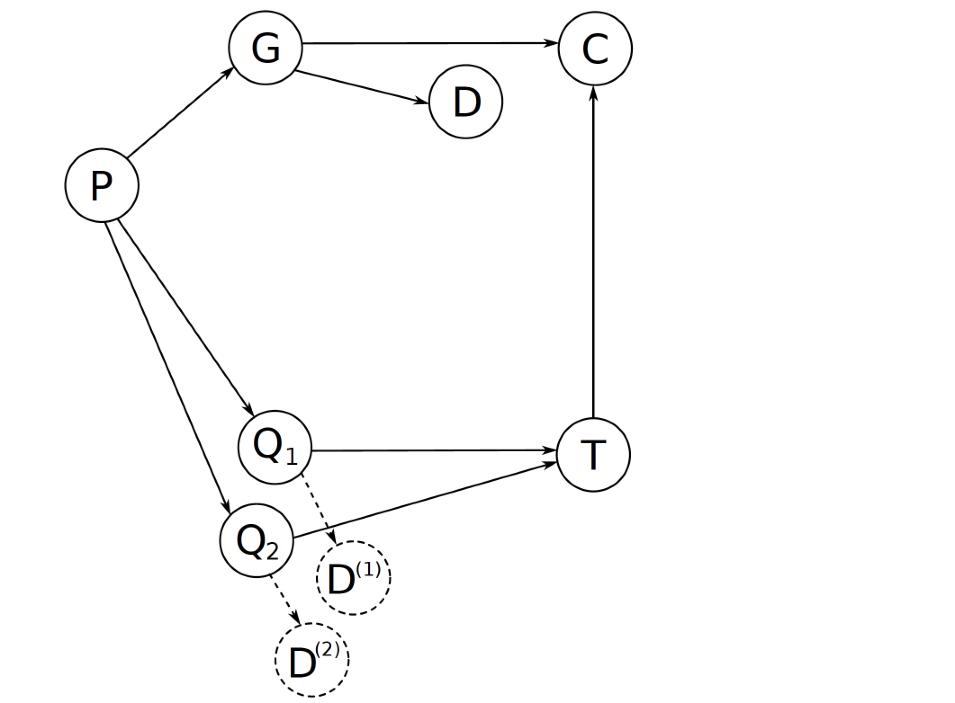
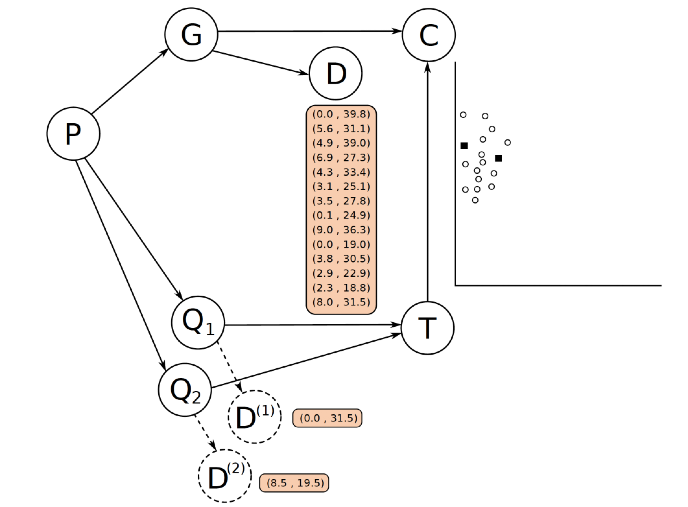
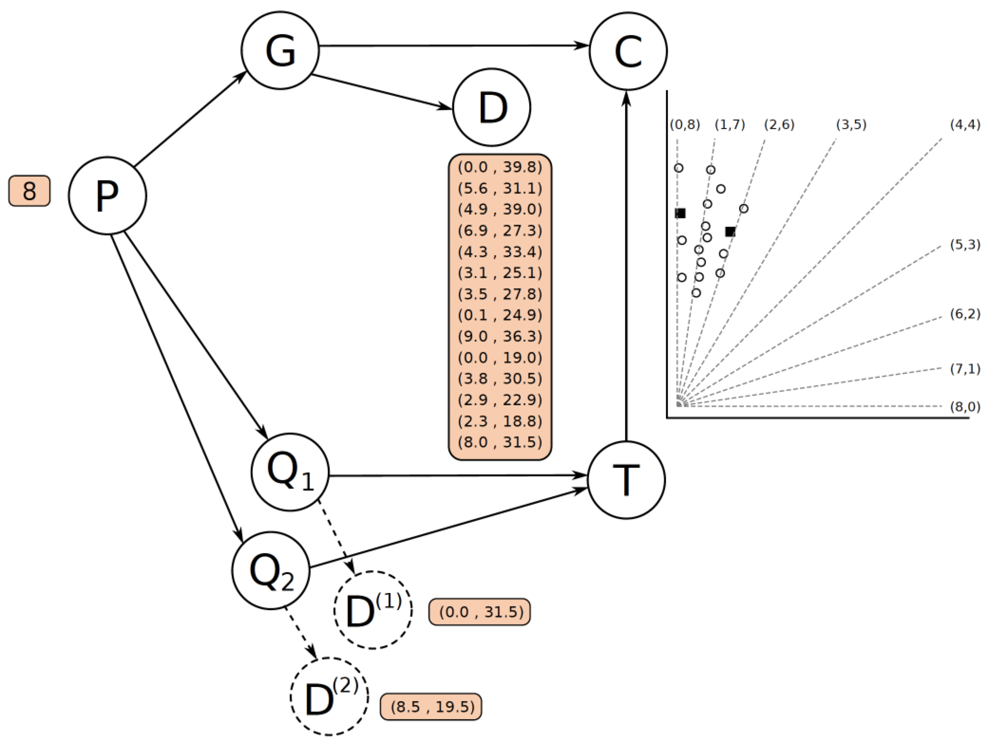
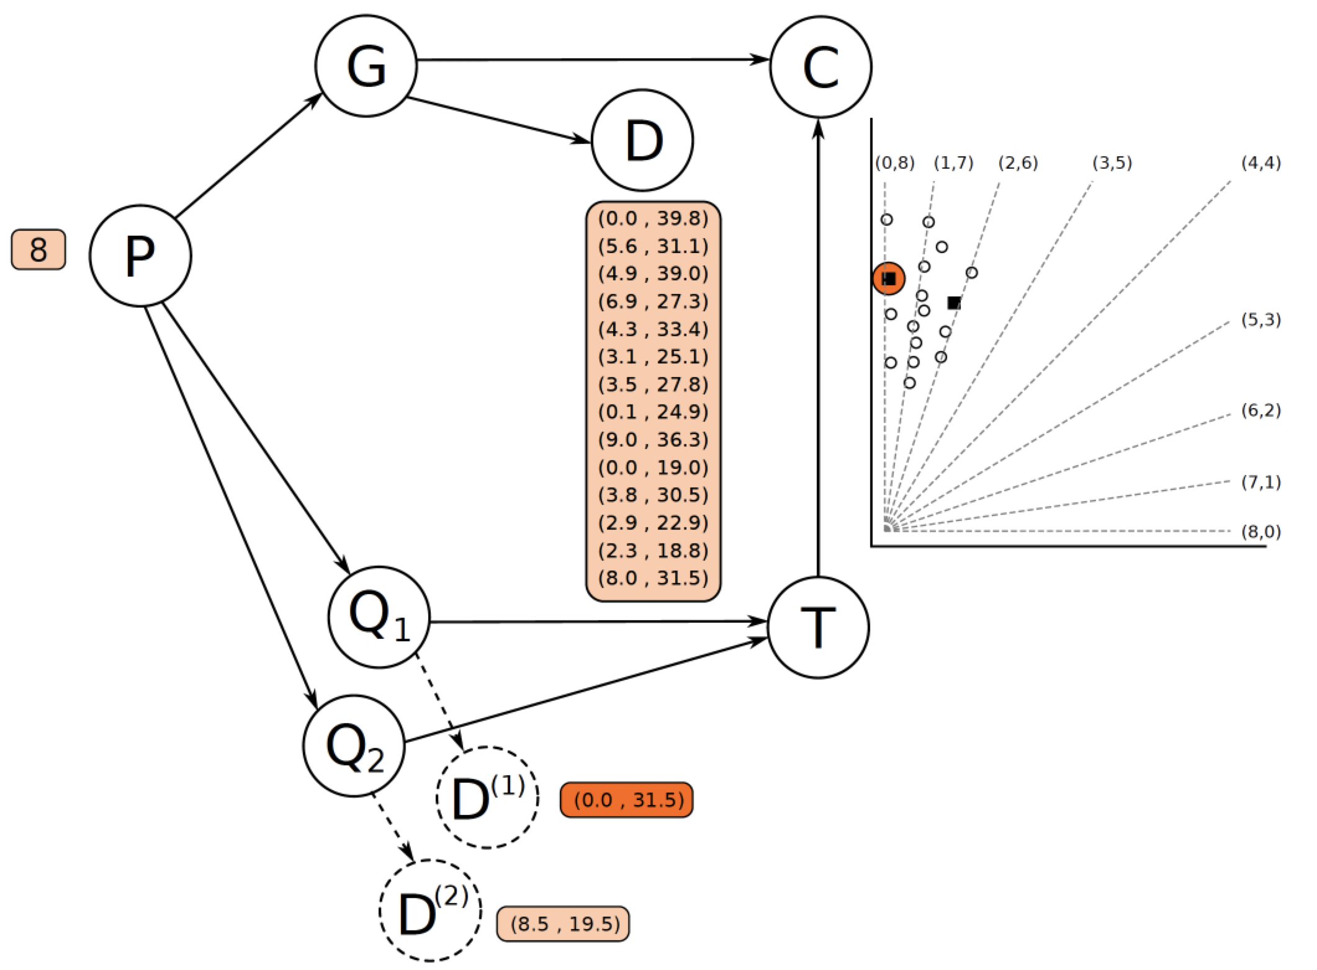
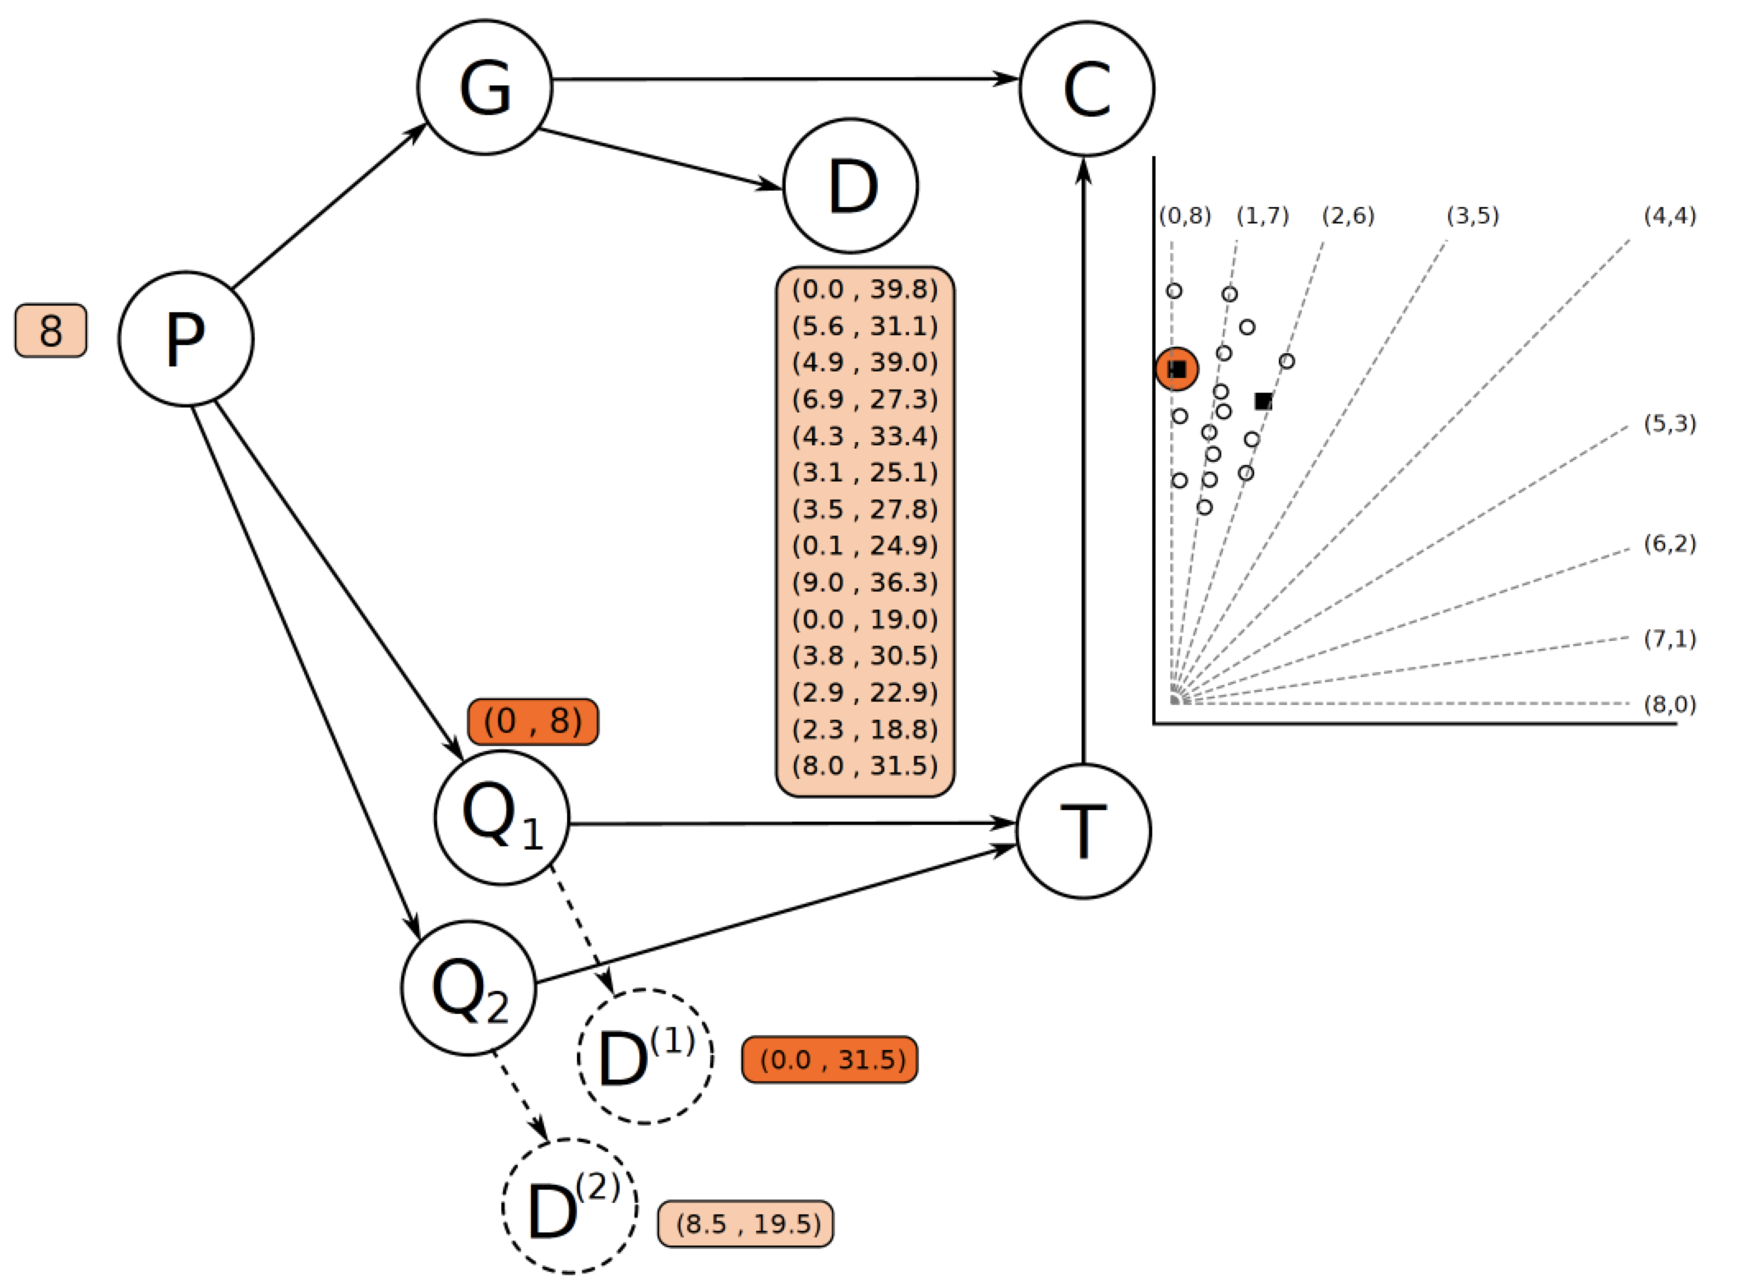
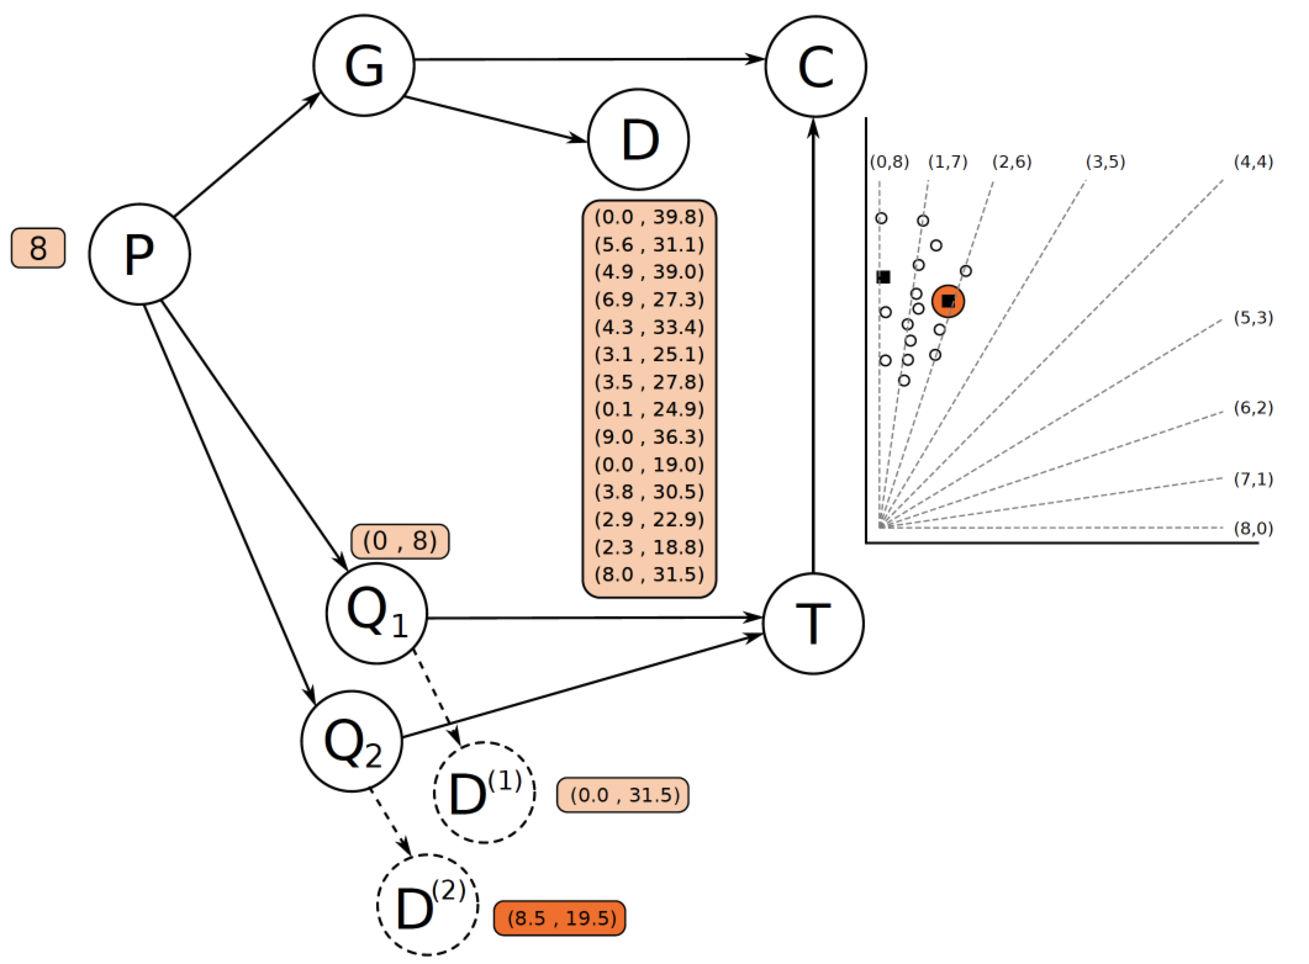
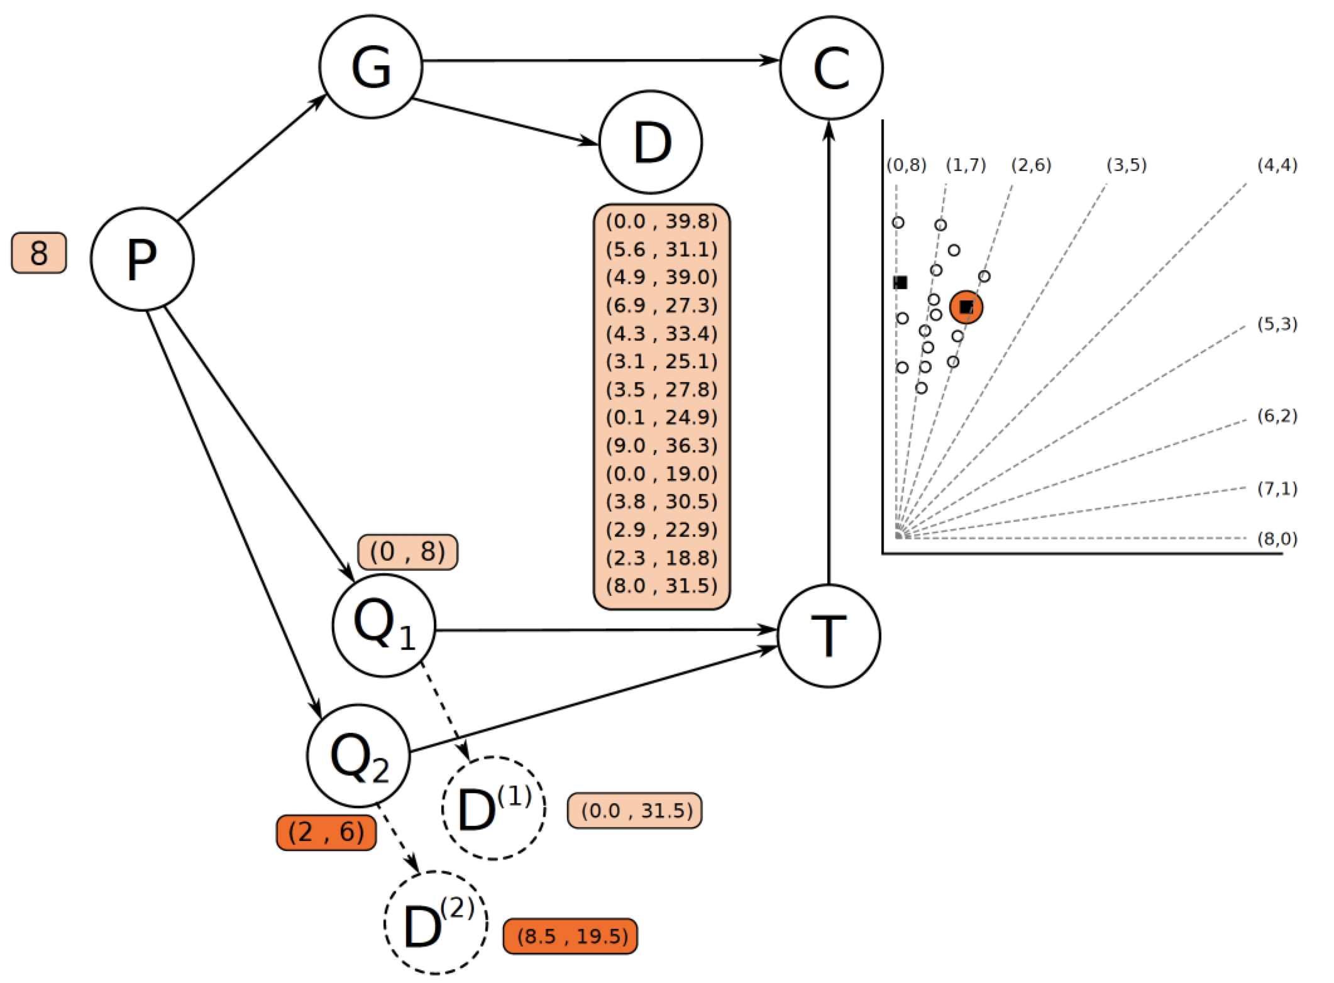
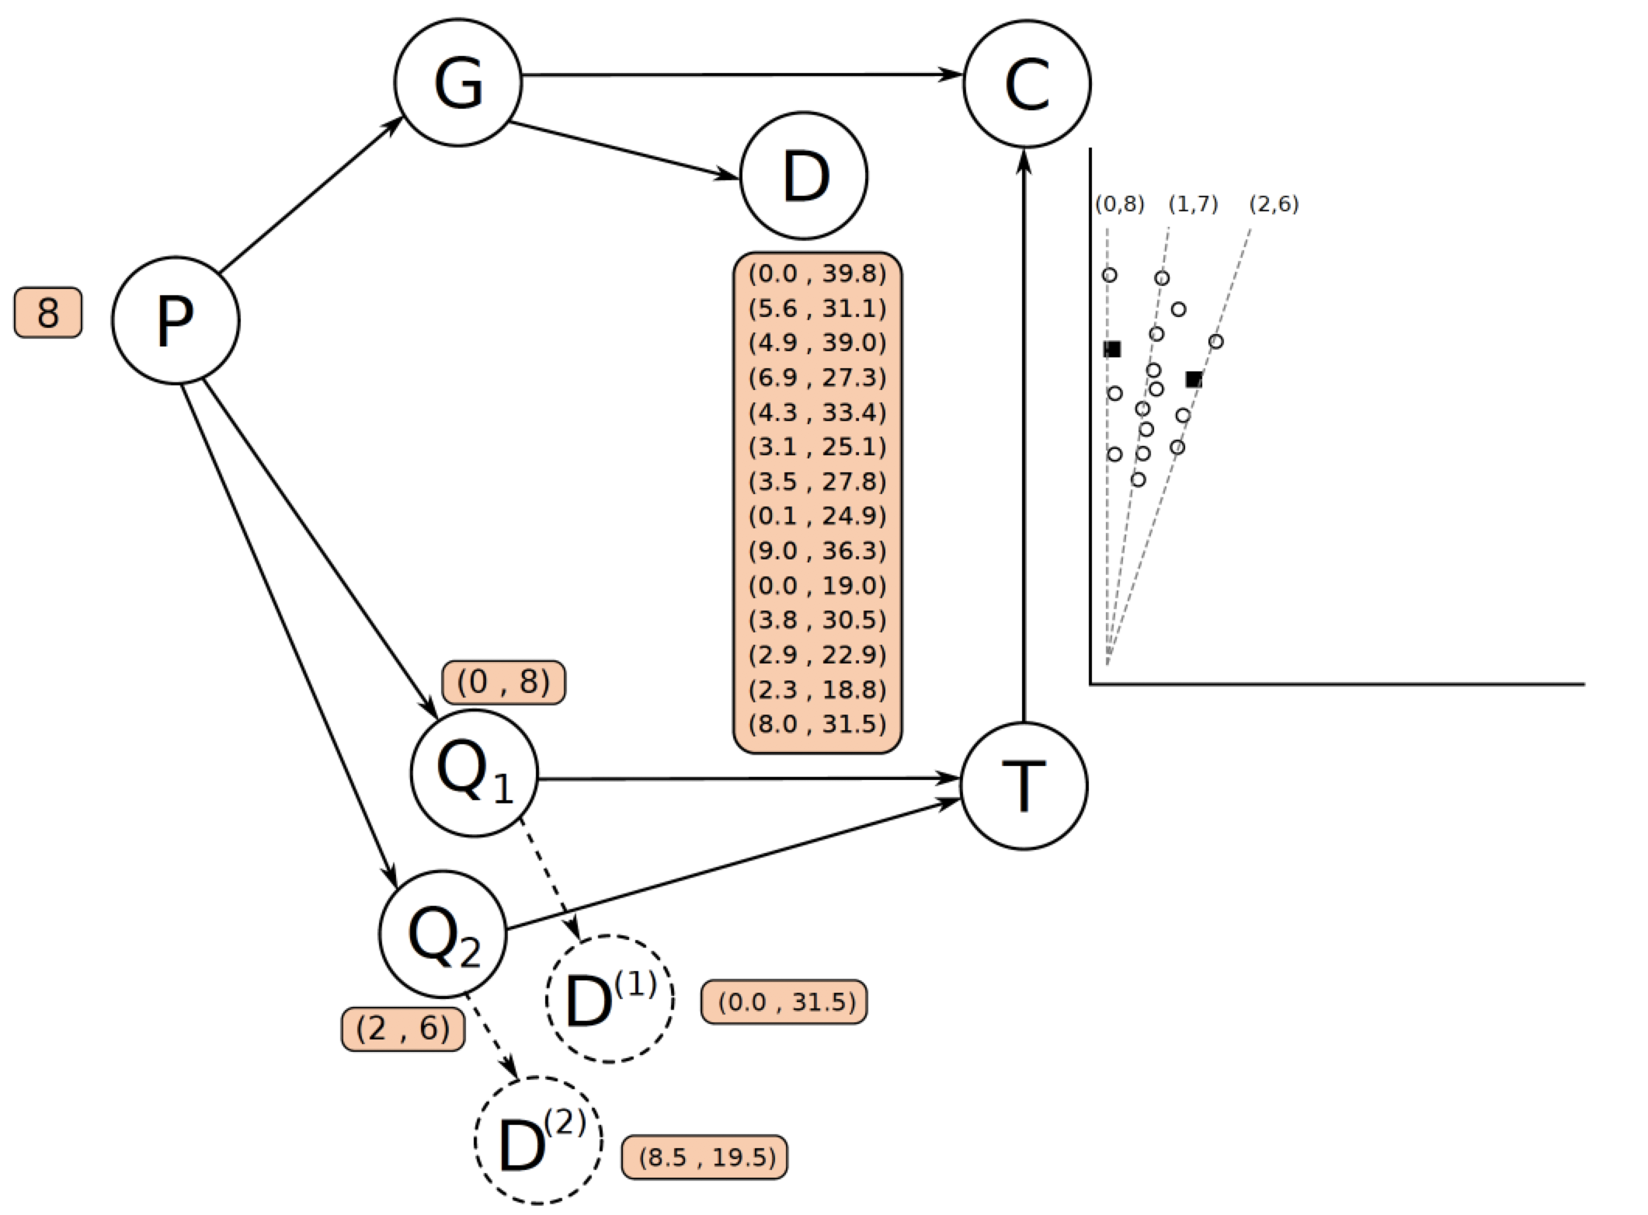
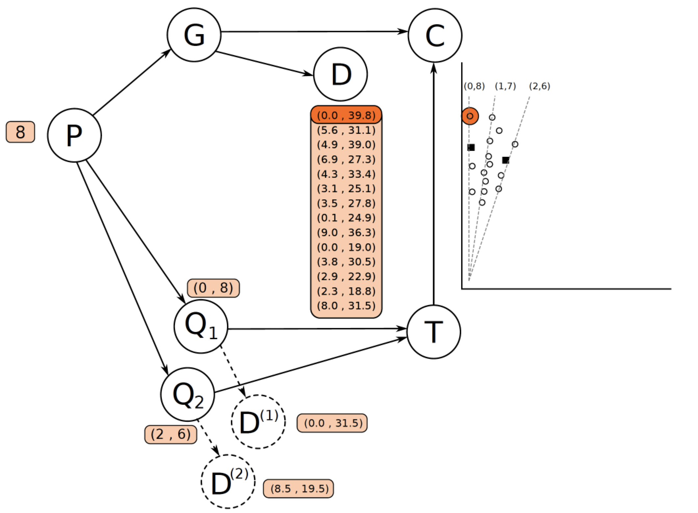
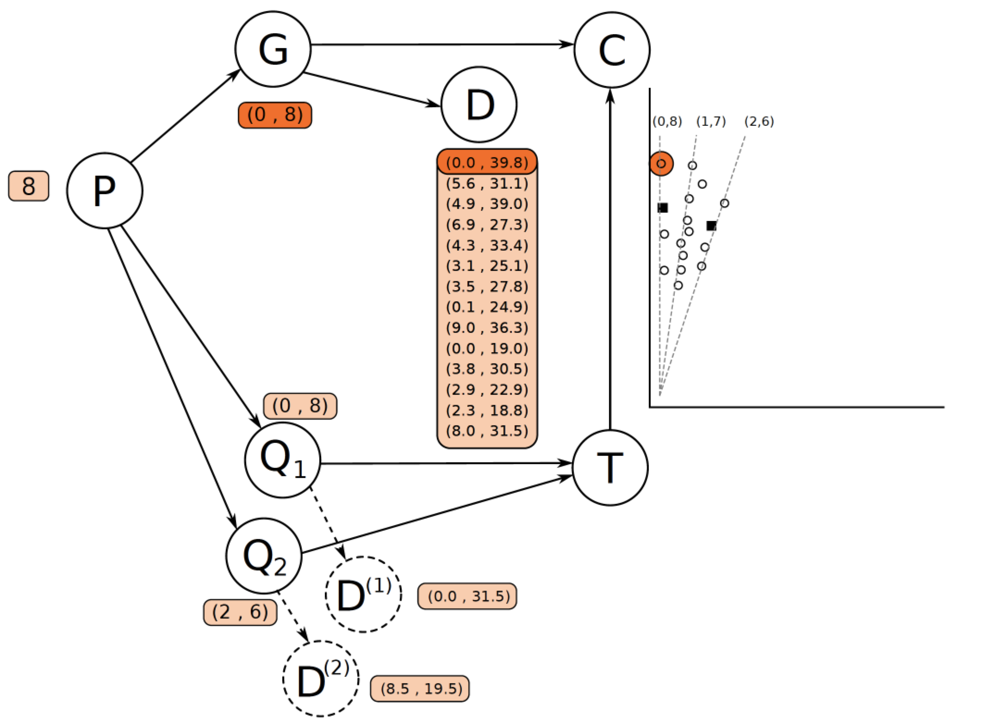
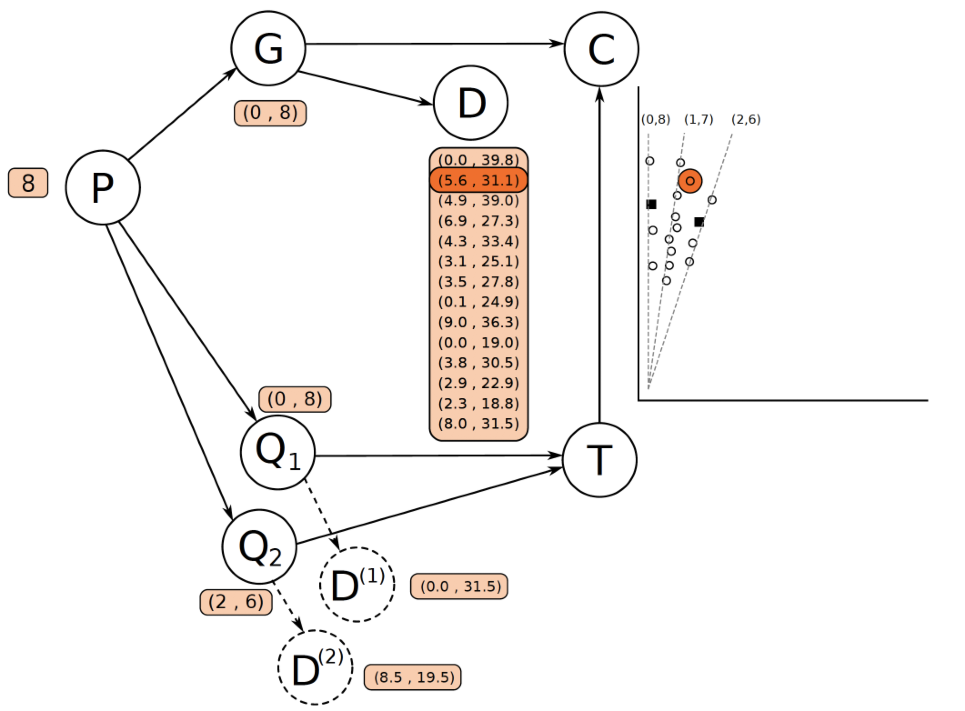
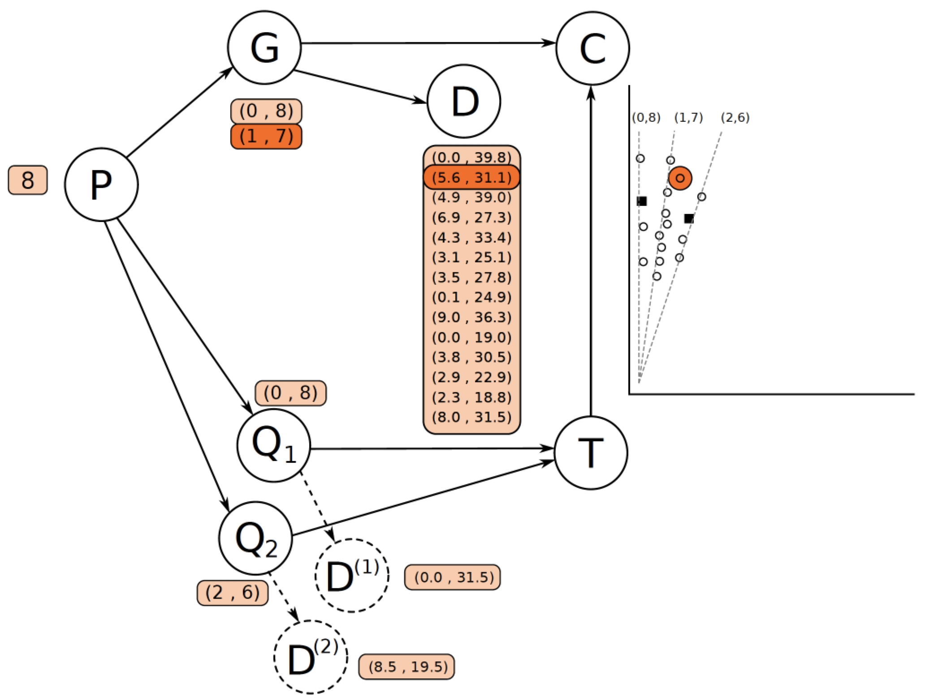
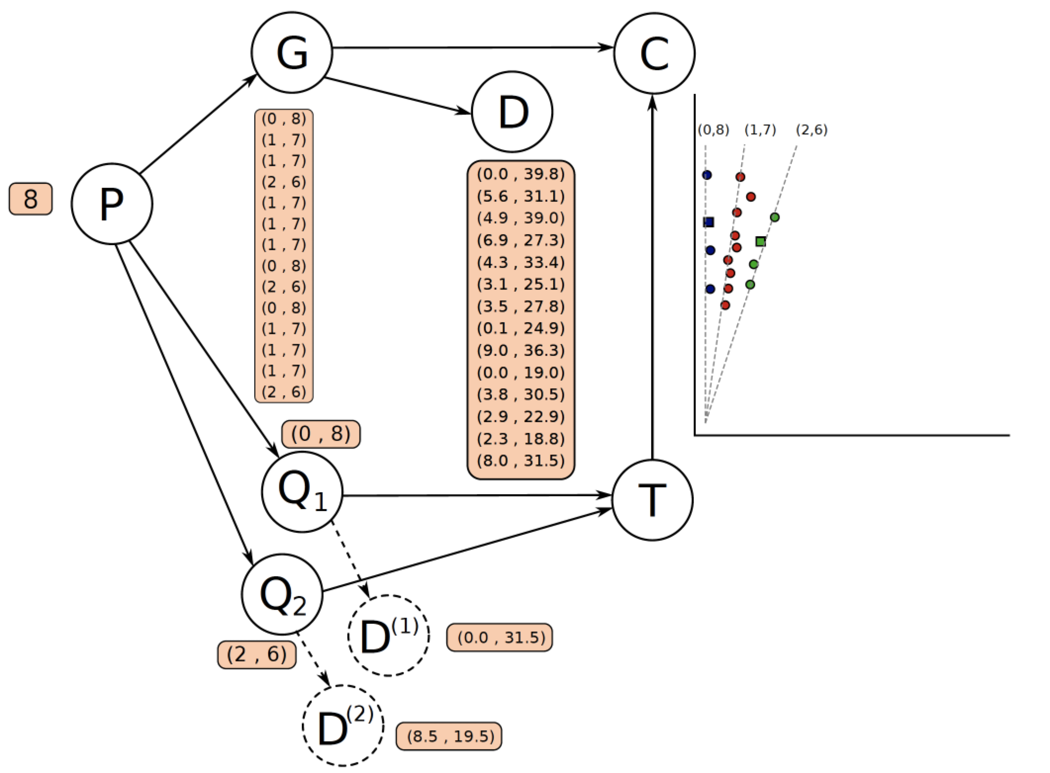
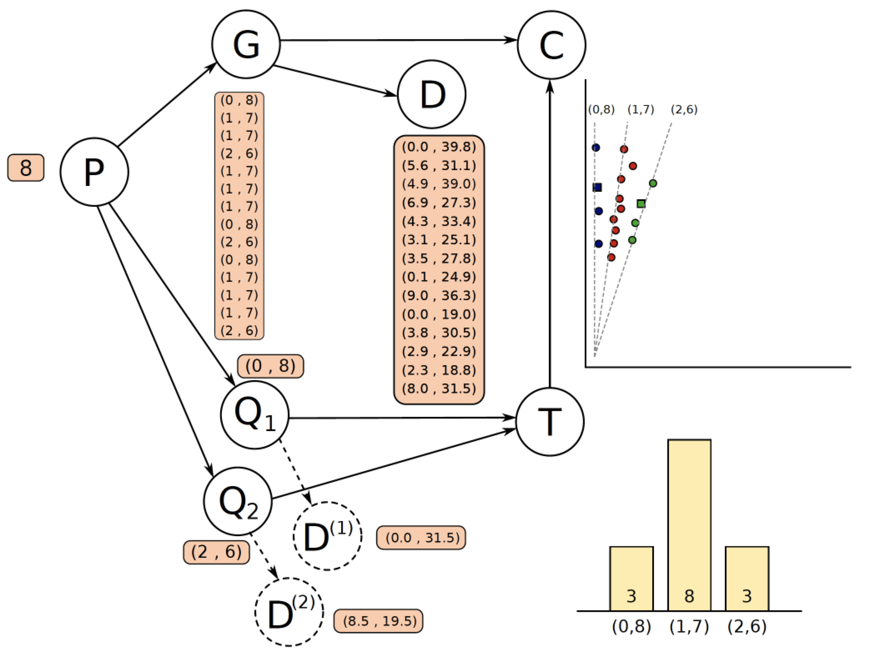
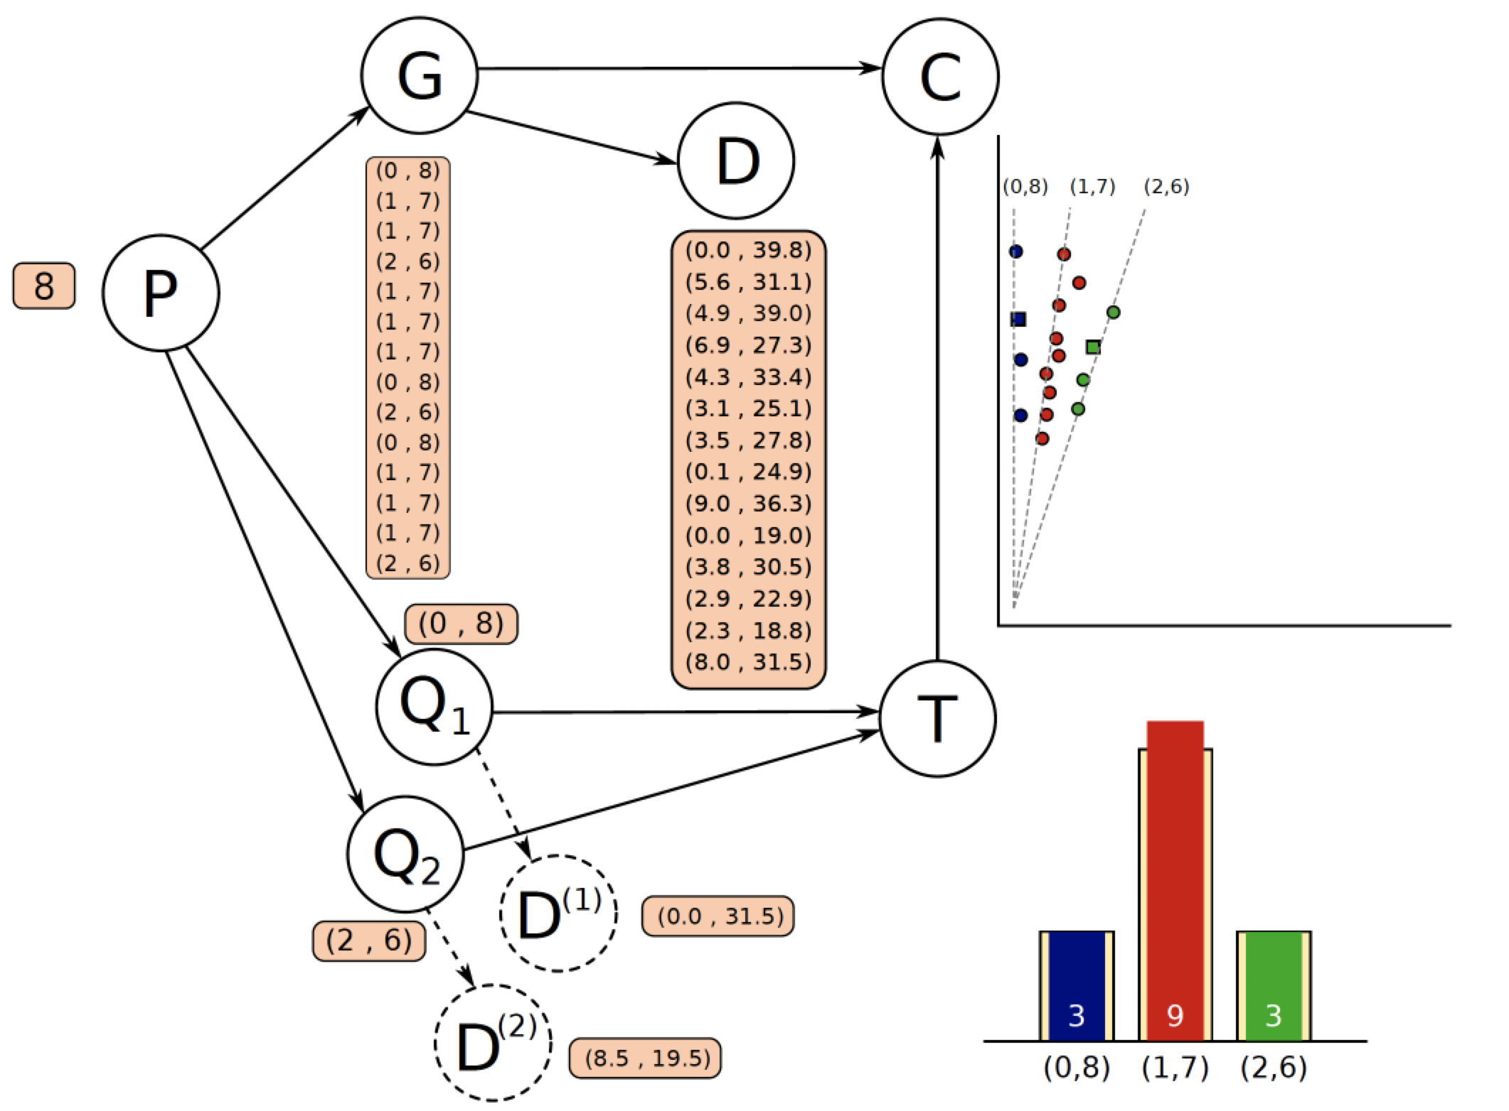
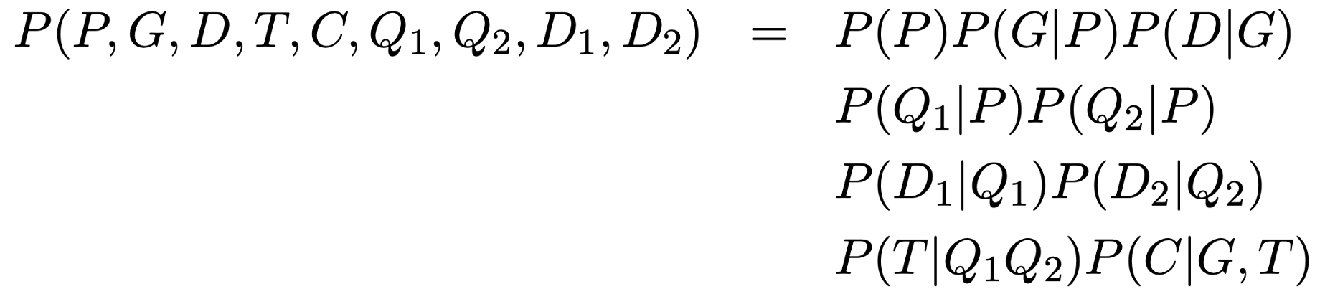
Probabilistic graphical model

Slide 7
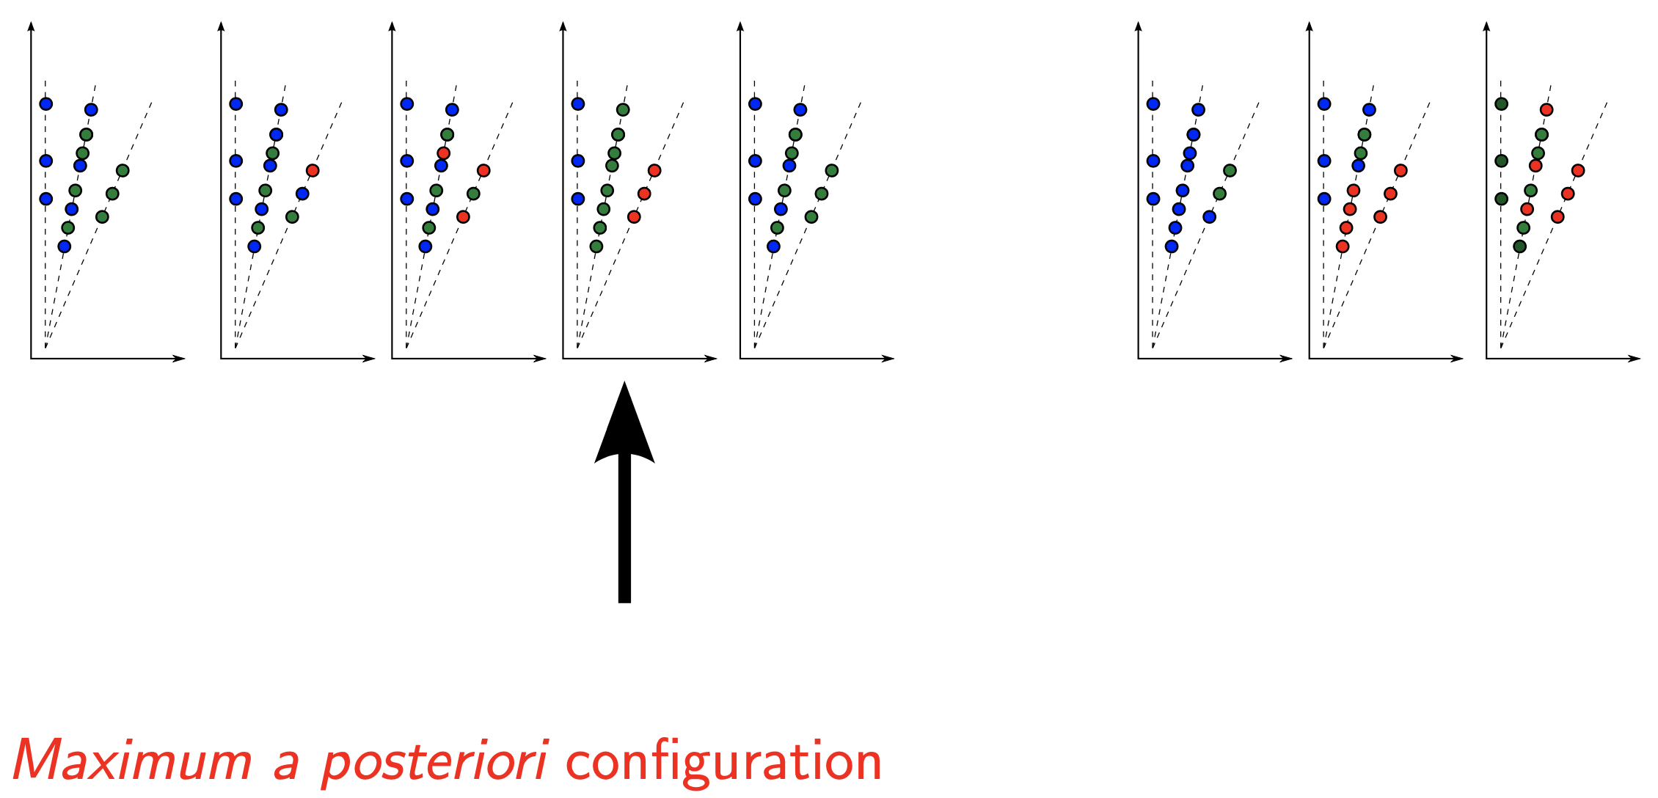
Probabilistic graphical model - MAP
Ploidy level with associated probability, parents and offspring genotypes (dosage calls)

Slide 8
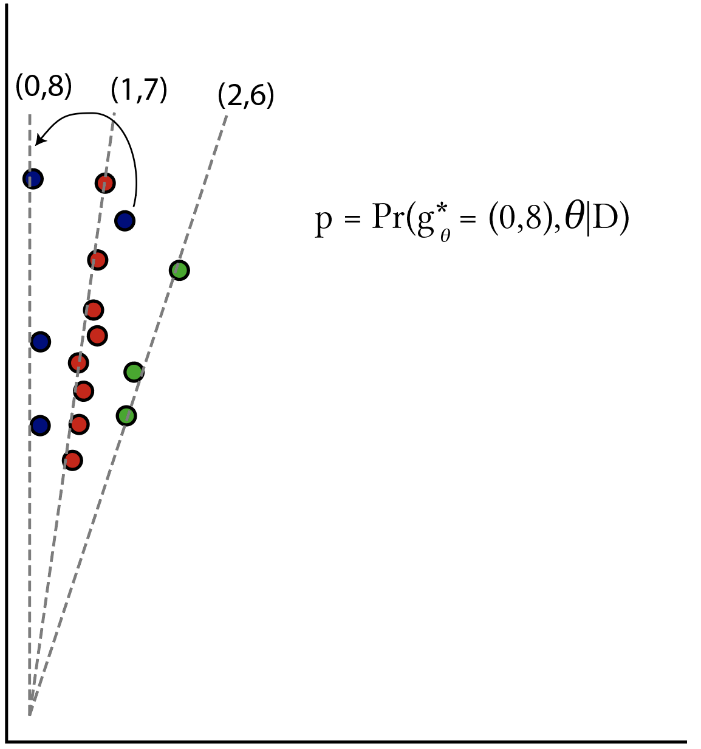
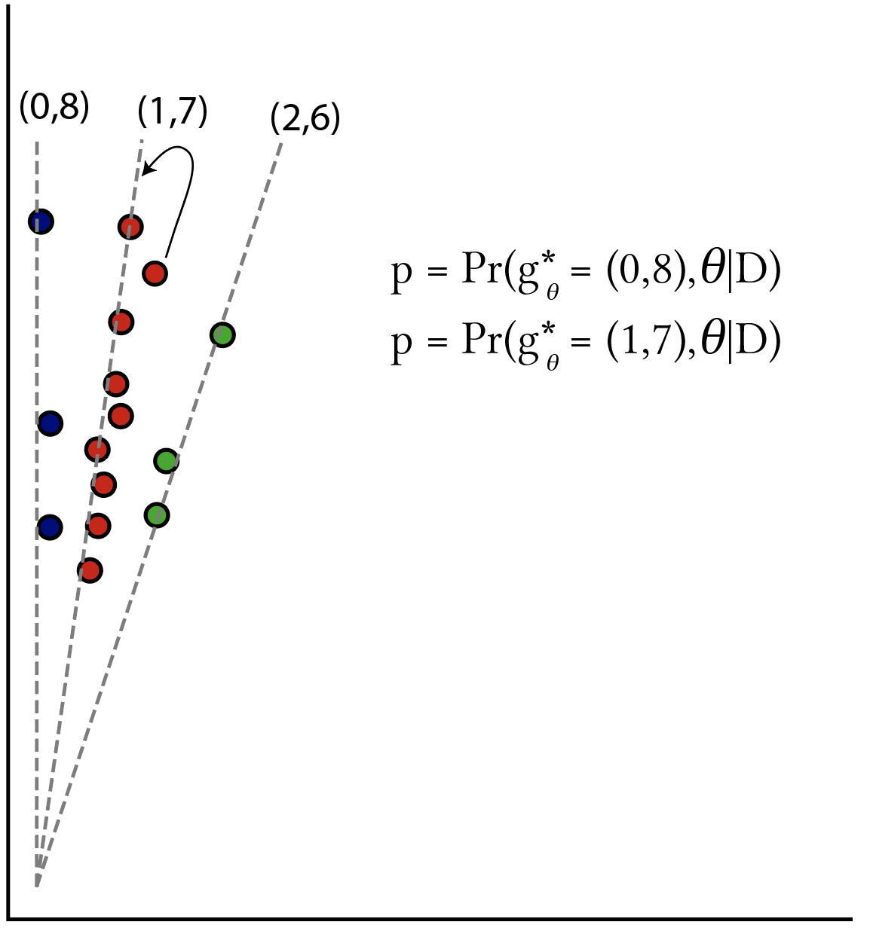
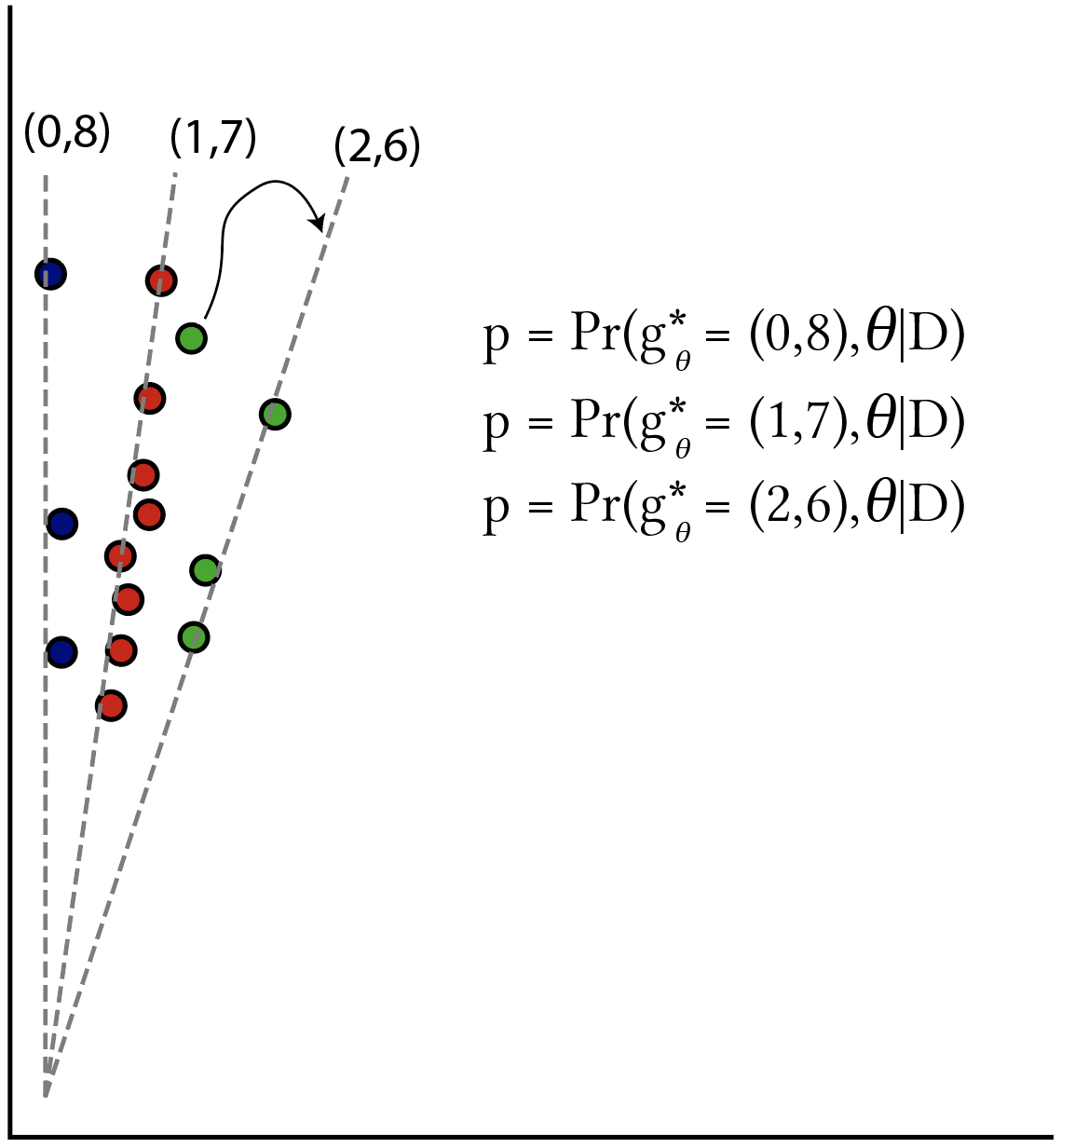
Individual (naïve) probabilities
What is the probabilities that an individual was assigned to the correct genotype?

Slide 9
Installing Python 2.7
Windows (tested on Windows 10):
https://www.python.org/ftp/python/2.7.16/python-2.7.16.amd64.msi
Change directory to C:\Python27\Scripts
pip install matplotlib
MAC (tested on MacOS Catalina 10.15.7)
https://www.python.org/ftp/python/2.7.18/python-2.7.18-macosx10.9.pkg
pip install matplotlib
Linux (tested on Ubuntu 20.04)
sudo apt install python2.7 python-pip
pip install matplotlib

Slide 10

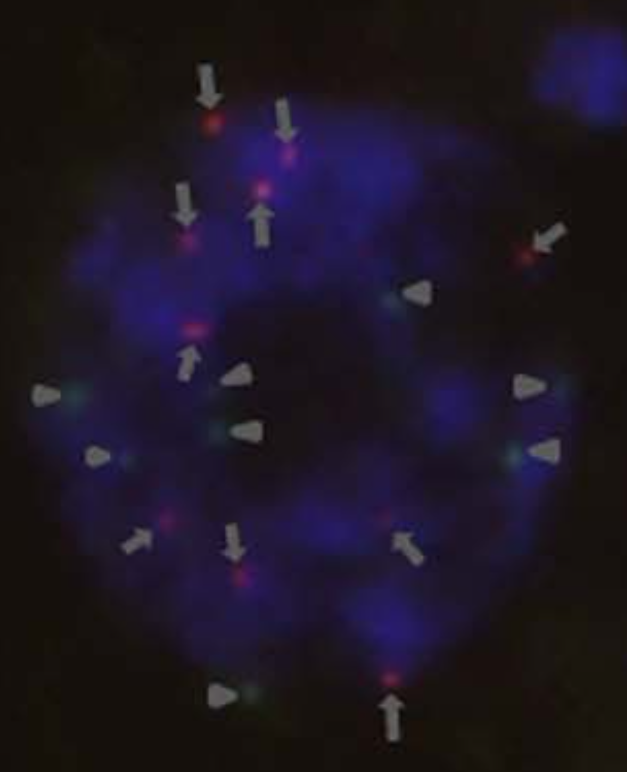
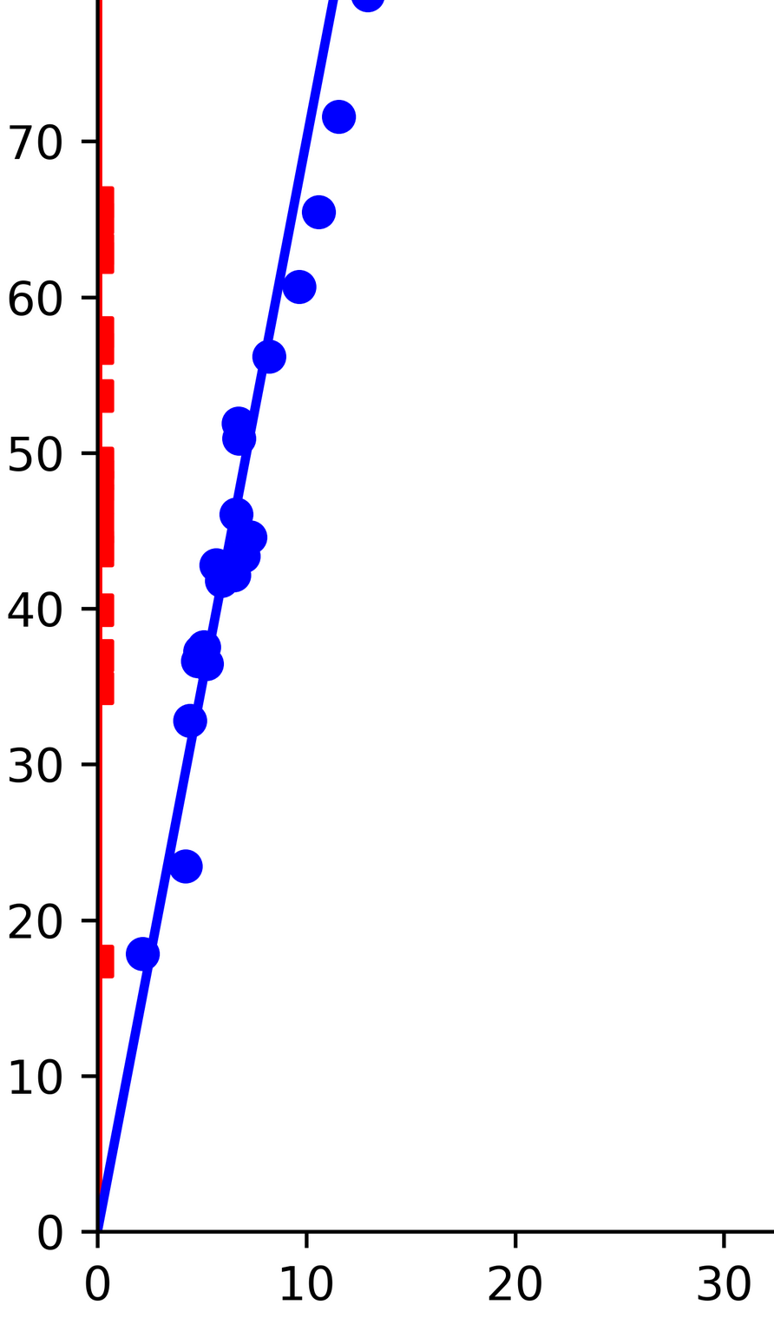
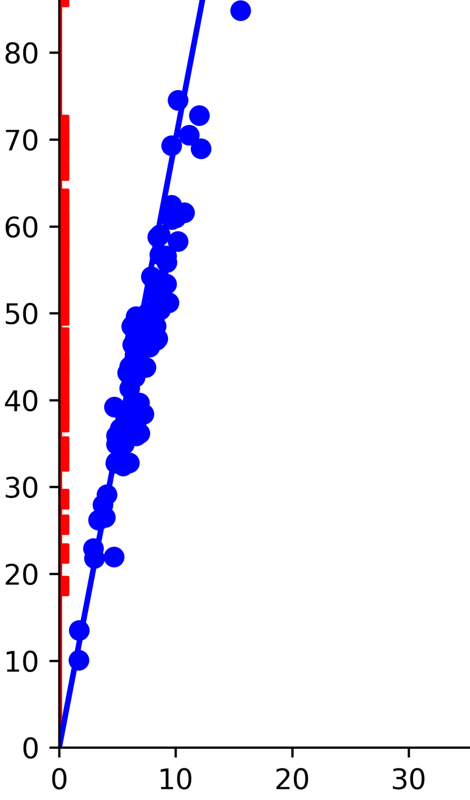
Ploidy level estimation in a sugarcane biparental population
python2.7 ../supermassa/src/SuperMASSA.py --print_genotypes --inference f1 --ploidy_range 2:12 \
--file sugarcane_data/SugSNP_382.pro --f1_parent_data sugarcane_data/SugSNP_382.par
--naive_posterior_reporting_threshold 0.8 --draw_genotypes --draw_genotype_histogram
--save_figures "SugSNP_382" > SugSNP_382.html
Results
Pr(G = g*, parameter* | D) = 1.0
'ploidy': 8
'parameter': ((0, 8), (1, 7)) Predicted genotypes
1 (1, 7) 10 (0, 8) 101 (0, 8) 102 (1, 7) 103 (1, 7) 104 (0, 8) 105 (1, 7) 106 (1, 7) 107 (0, 8) 109 (0, 8) 11 (0, 8) ...
parents
offspring
https://doi.org/10.1038/srep03399

Slide 11
Genotype calling in a sweetpotato biparental population using VCF2SM
-I: f1 or hw for respective biparental or Hardy-Weinberg model; ploidy will use exclusively the ratio between abundances
-p: Minimum posterior probability to keep variant
-n: In the example, we use -n 0.80 to only keep samples with an associated probability of 0.80 or higher.
-c: To exclude loci with excessive missing data, we require a call rate of 0.75 or higher (-c 0.75). Note that only samples passing the naive reporting probability filter are considered as valid calls, i.e., samples that have allele depth information but do not fit well to any genotype group are treated as missing.
python2.7 VCF2SM.py -i ../data/sample_vcf/sample_ch+.vcf \
-o sample_trifida_sm_chr+.vcf \
--sF 1 \
--eF 3 \
-d 20 \
-D 2000 \
-g BT \
-1 Beauregard \
-2 Tanzania \
-S ~/repos/supermassa/src/SuperMASSA.py \
-I f1 \
-M 2:6 \
-f 6 \
-p 0.80 \
-n 0.75 \
-c 0.75 \
-t 24
https://github.com/guilherme-pereira/vcf2sm

Slide 12
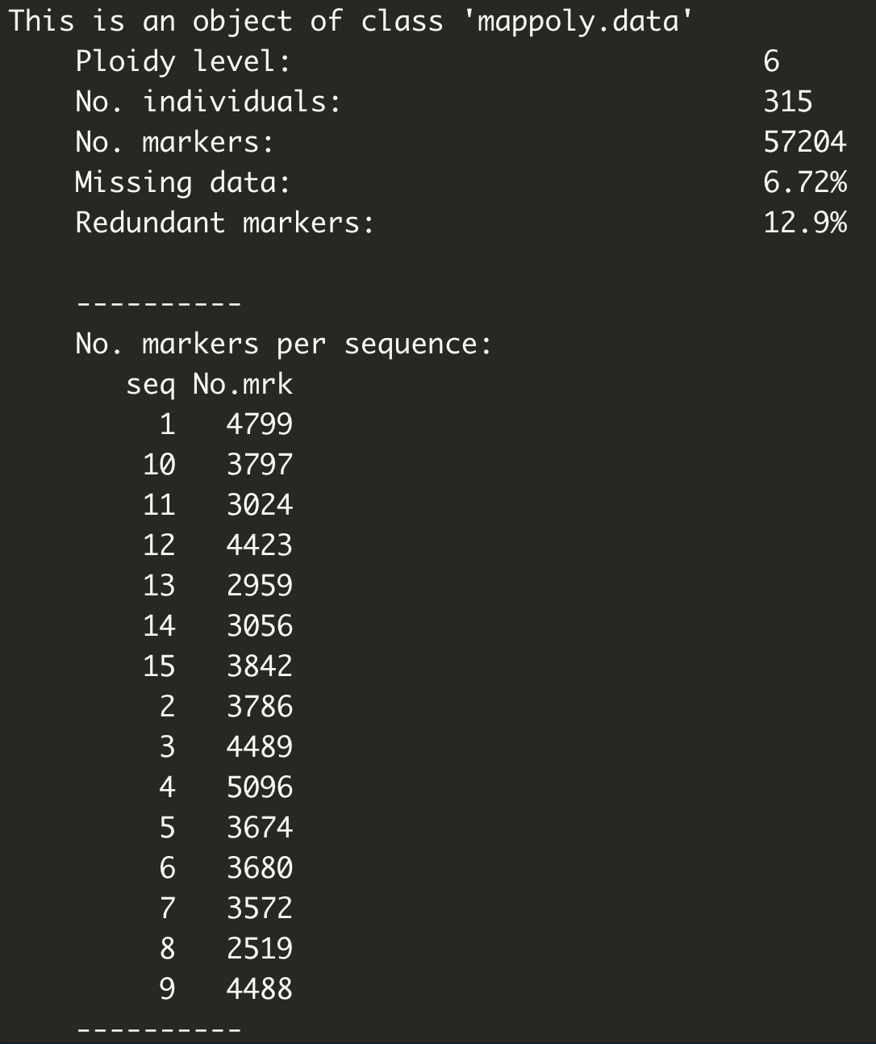
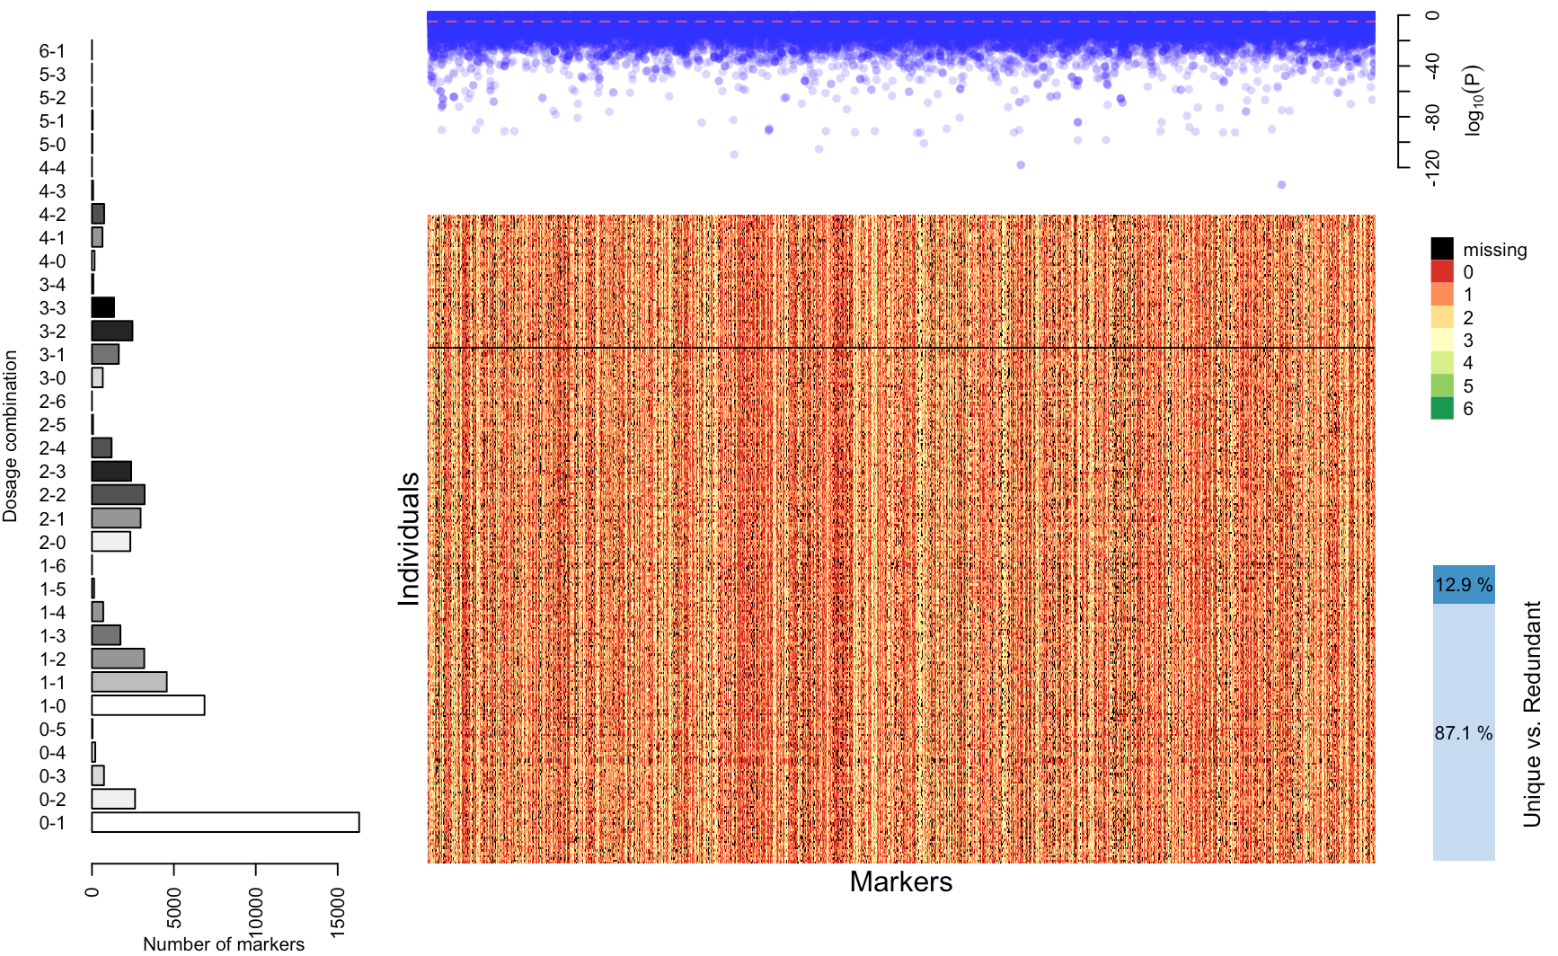
Genotype calling in a sweetpotato biparental population using VCF2SM

